Slide 1
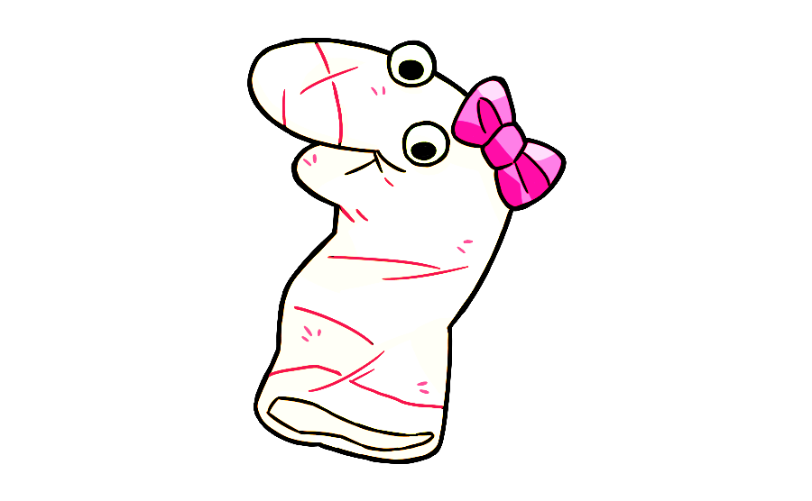
Notes:
This is Maggie! Say high to Maggie. Hi Maggie [wiggle]. Maggie wants to learn what things are for. And today you are going to teach Maggie what different things are for. Are you ready to help Maggie? OK, let’s help Maggie!

Slide 2
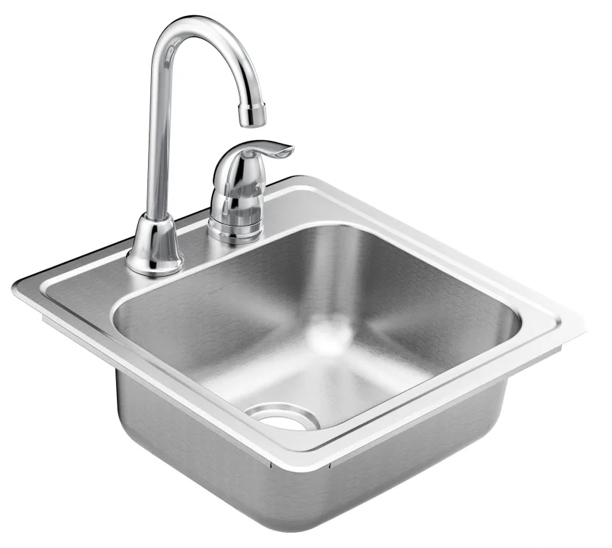
Notes:
See this [wiggle]? This is a sink! Can you tell Maggie what sinks are for?

Slide 3


Notes:
Thanks so much for helping Maggie! Let’s see the next thing!

Slide 4
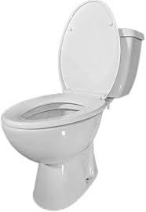
Notes:
See this [wiggle]? This is a toilet! Can you tell Maggie what toilets are for?

Slide 5
Notes:
Thanks so much for helping Maggie! Let’s see the next thing!

Slide 6
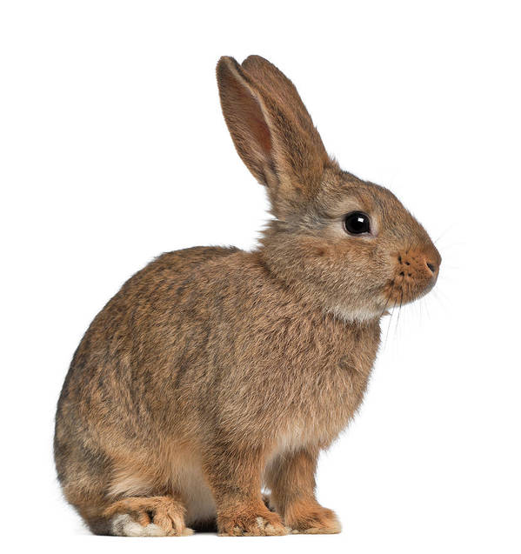
Notes:
See this [wiggle]? This is a bunny! Can you tell Maggie what bunnies are for?

Slide 7
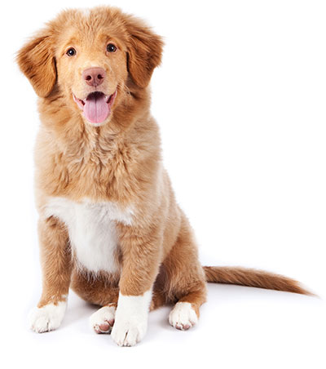
Notes:
See this [wiggle]? This is a dog! Can you tell Maggie what dogs are for?

Slide 8
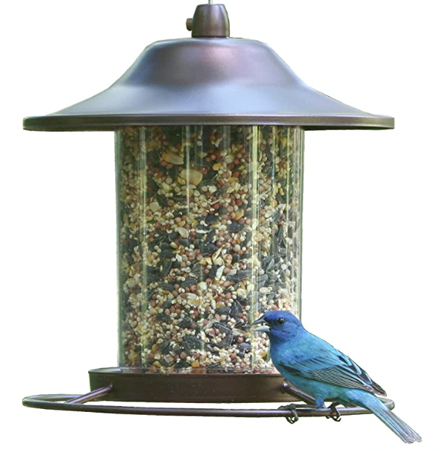
Notes:
See this [wiggle]? This is a bird feeder! Can you tell Maggie what bird feeders are for?

Slide 9
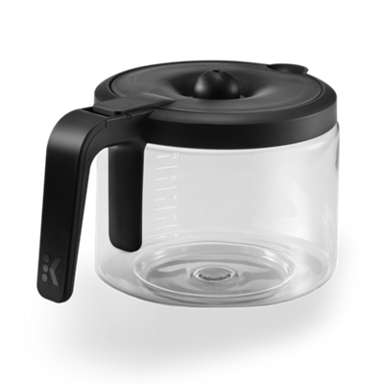
Notes:
See this [wiggle]? This is a coffee pot! Can you tell Maggie what coffee pots are for?

Slide 10
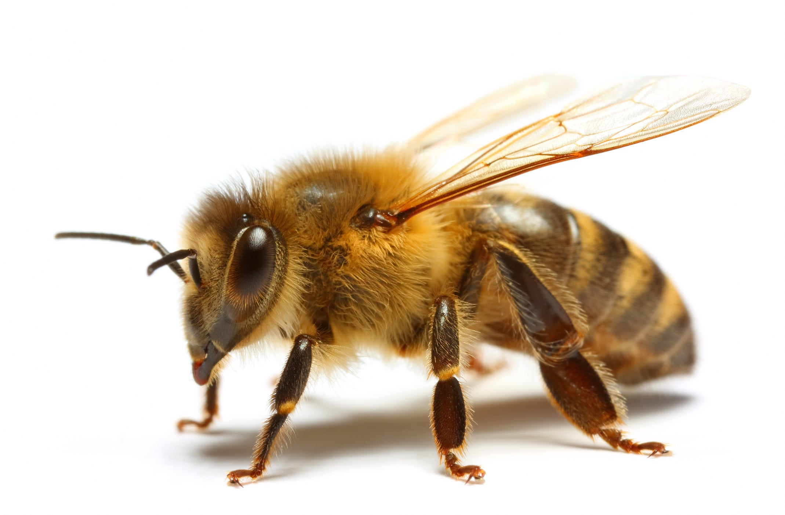
Notes:
See this [wiggle]? This is a bee! Can you tell Maggie what bees are for?

Slide 11
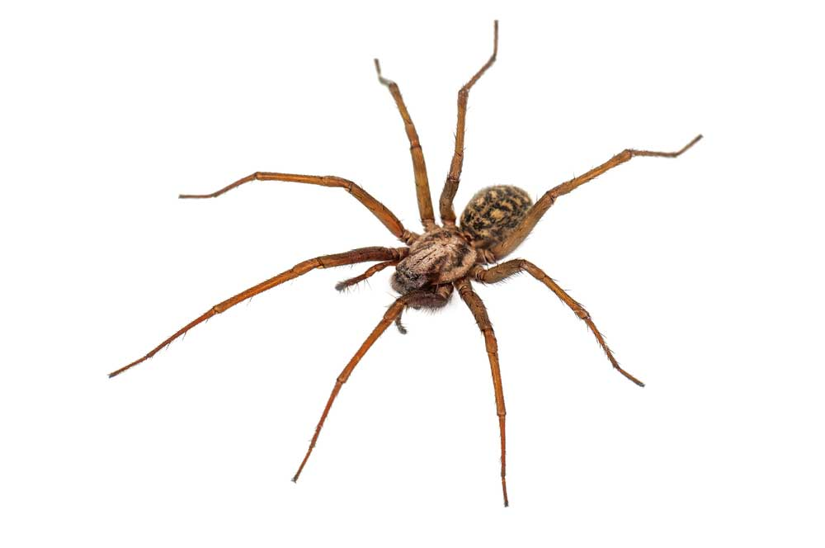
Notes:
See this [wiggle]? This is a spider! Can you tell Maggie what spiders are for?

Slide 12
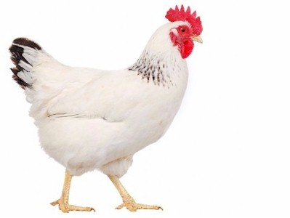
Notes:
See this [wiggle]? This is a chicken! Can you tell Maggie what chickens are for?

Slide 13
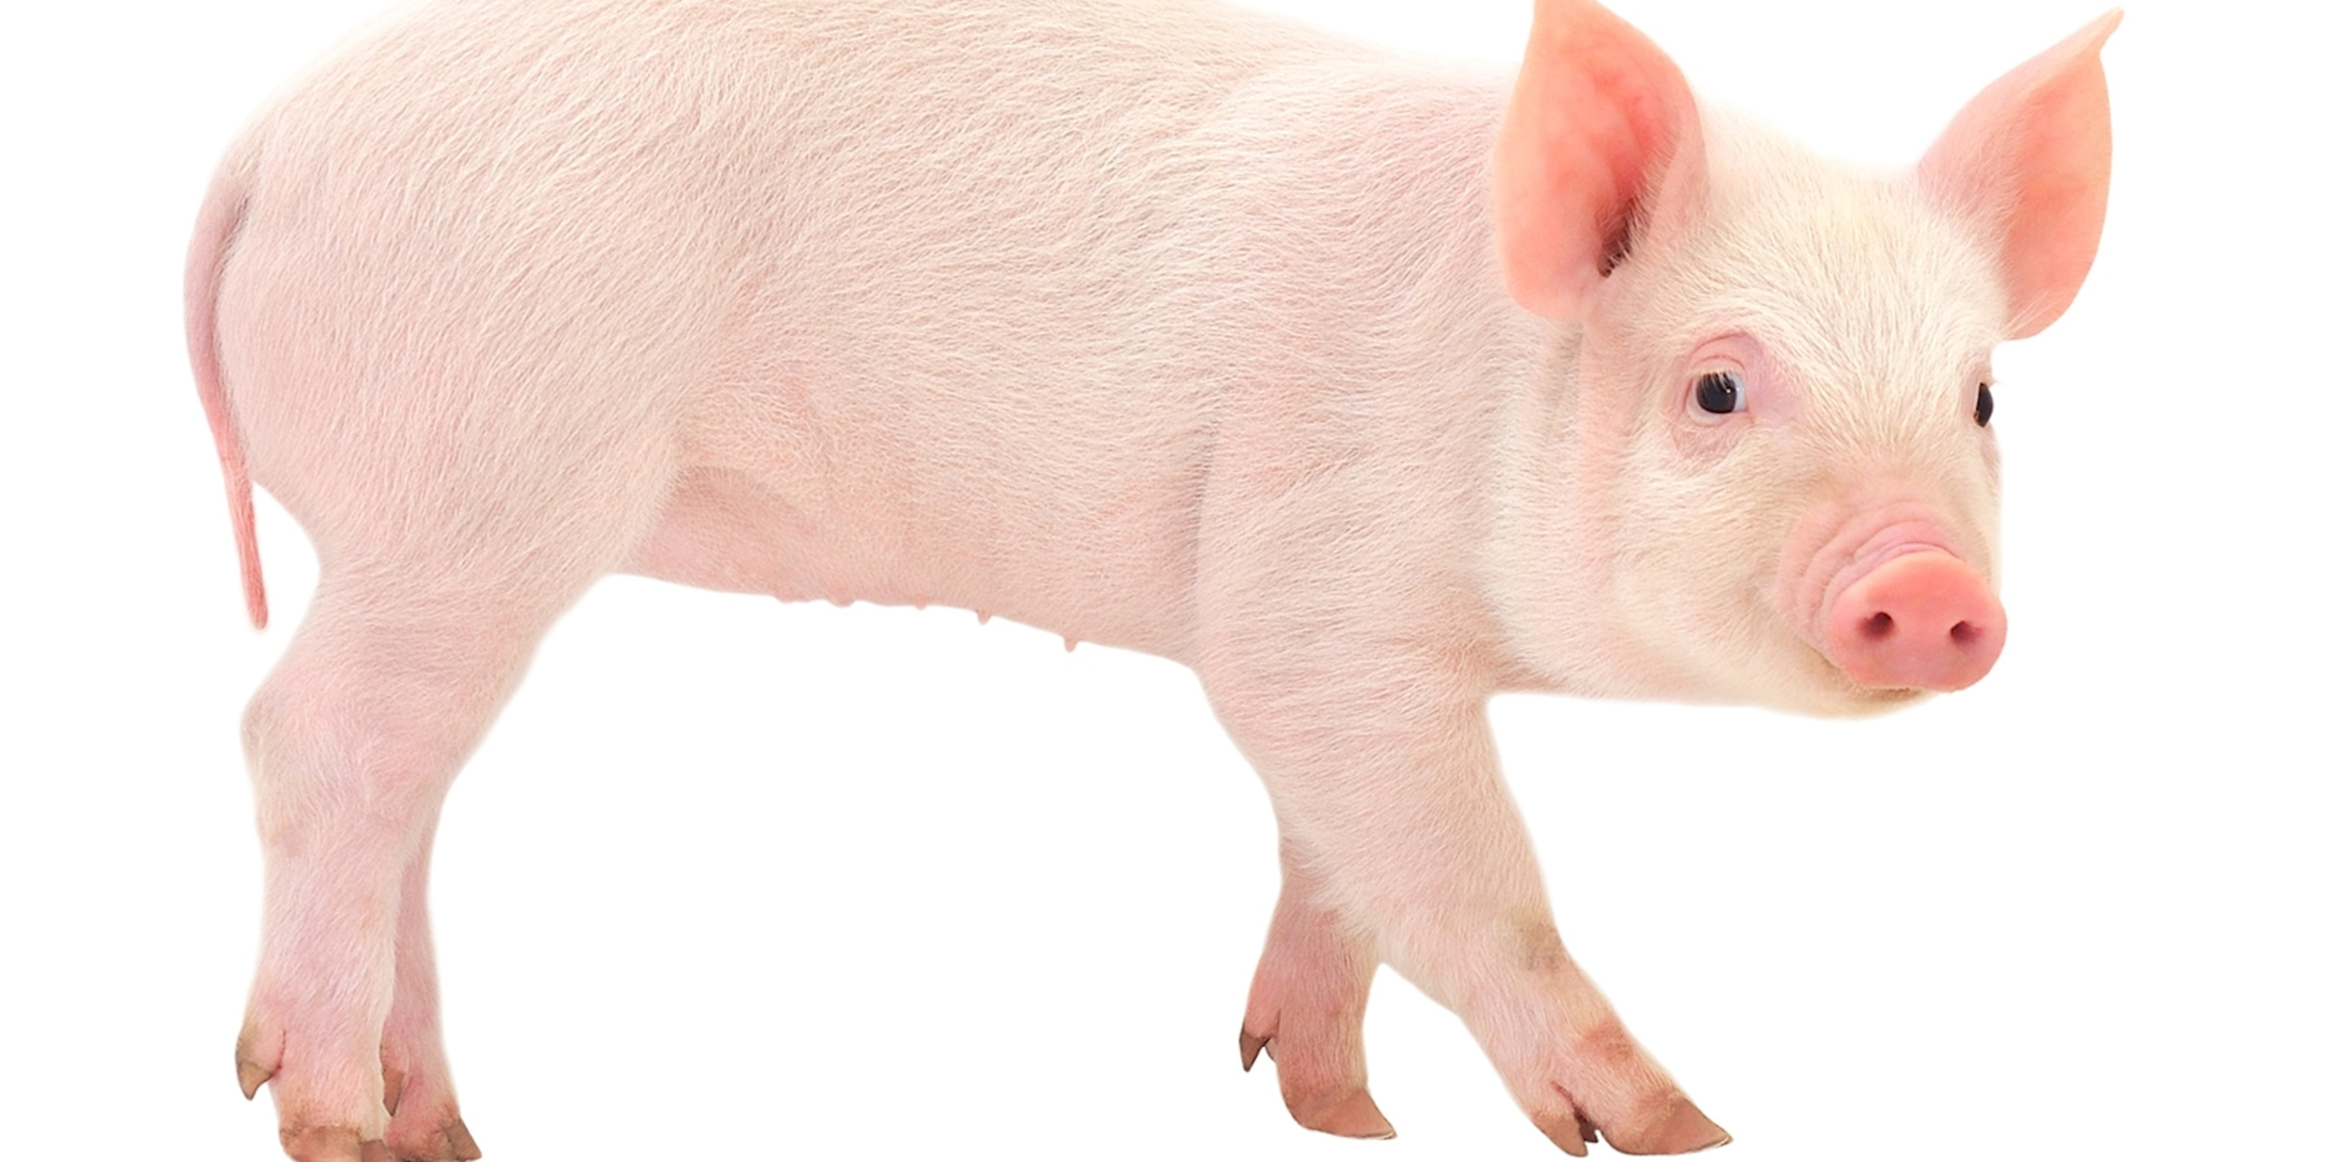
Notes:
See this [wiggle]? This is a pig! Can you tell Maggie what pigs are for?

Slide 14
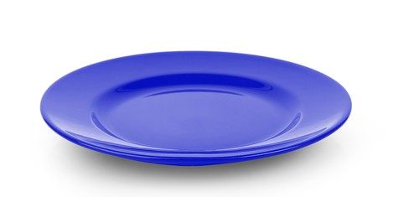
Notes:
See this [wiggle]? This is a plate Can you tell Maggie what plates are for?

Slide 15

Notes:
See this [wiggle]? This is a clock! Can you tell Maggie what clocks are for?

Slide 16
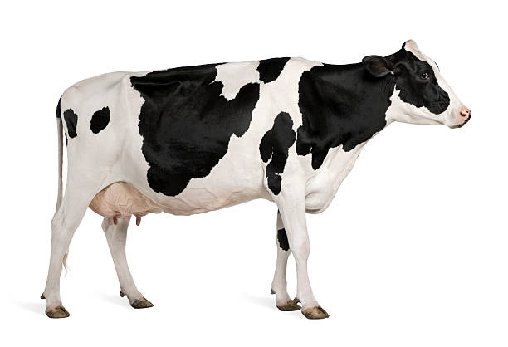
Notes:
See this [wiggle]? This is a cow! Can you tell Maggie what cows are for?

Slide 17
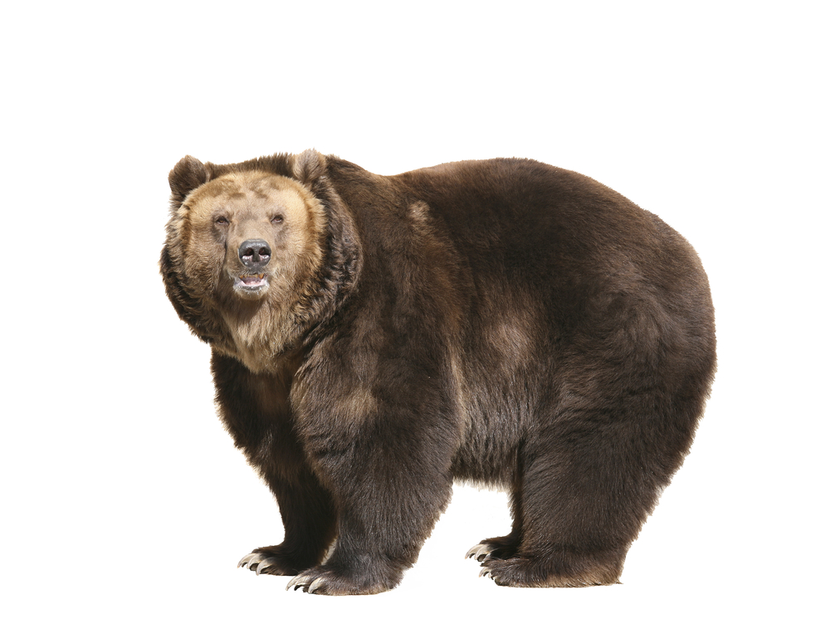
Notes:
See this [wiggle]? This is a bear! Can you tell Maggie what bears are for?

Slide 18
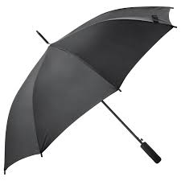
Notes:
See this [wiggle]? This is an umbrella! Can you tell Maggie what umbrellas are for?

Slide 19
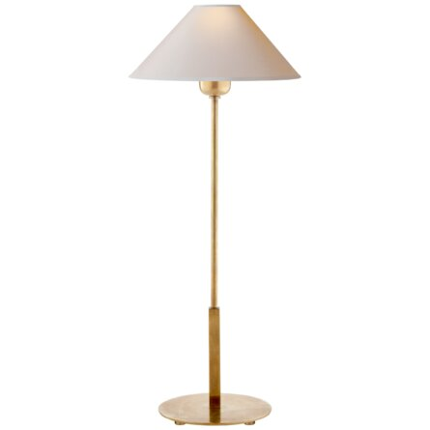
Notes:
See this [wiggle]? This is a lamp! Can you tell Maggie what lamps are for?

Slide 20
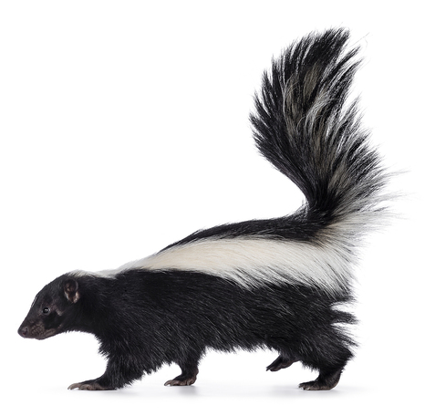
Notes:
See this [wiggle]? This is a skunk! Can you tell Maggie what skunks are for?

Slide 21
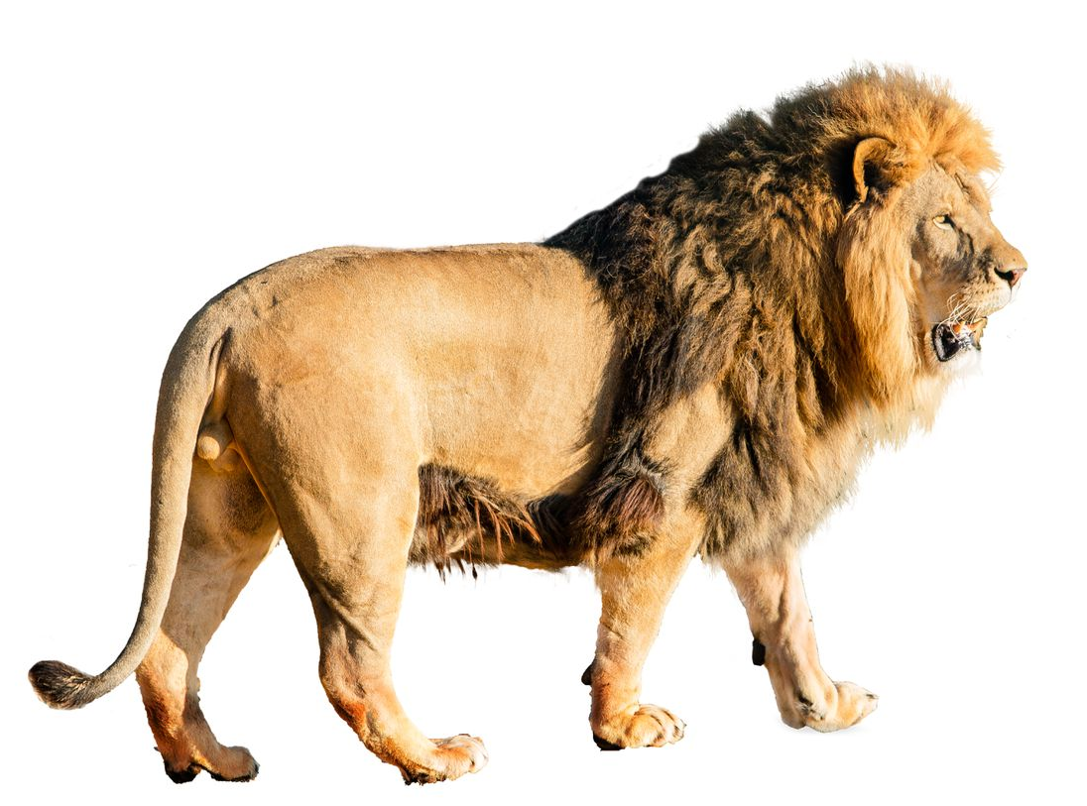
Notes:
See this [wiggle]? This is a lion! Can you tell Maggie what lions are for?

Slide 22
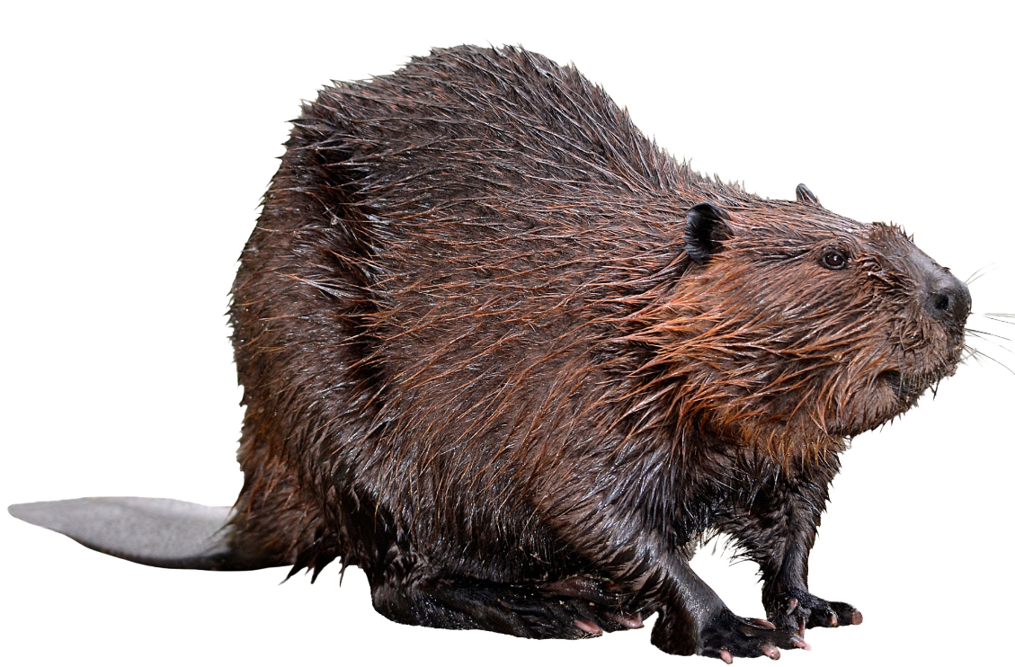
Notes:
See this [wiggle]? This is a beaver! Can you tell Maggie what beavers are for?

Slide 23
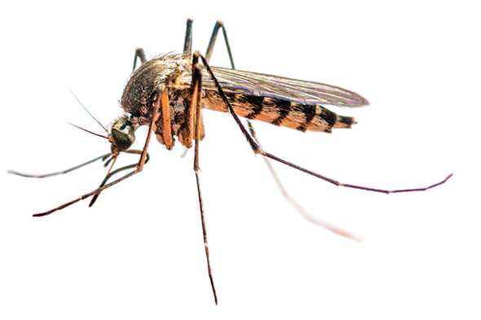
Notes:
See this [wiggle]? This is a mosquito! Can you tell Maggie what mosquitos are for?

Slide 24
Notes:
Thanks so much for helping Maggie! We are about half way done. Do you want to keep helping Maggie? OK great let’s keep helping Maggie!

Slide 25
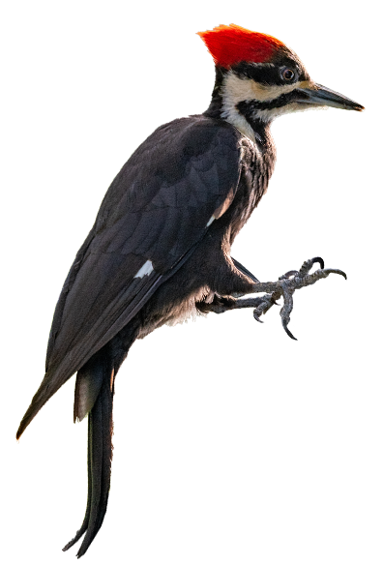
Notes:
See this [wiggle]? This is a woodpecker! Can you tell Maggie what woodpeckers are for?

Slide 26
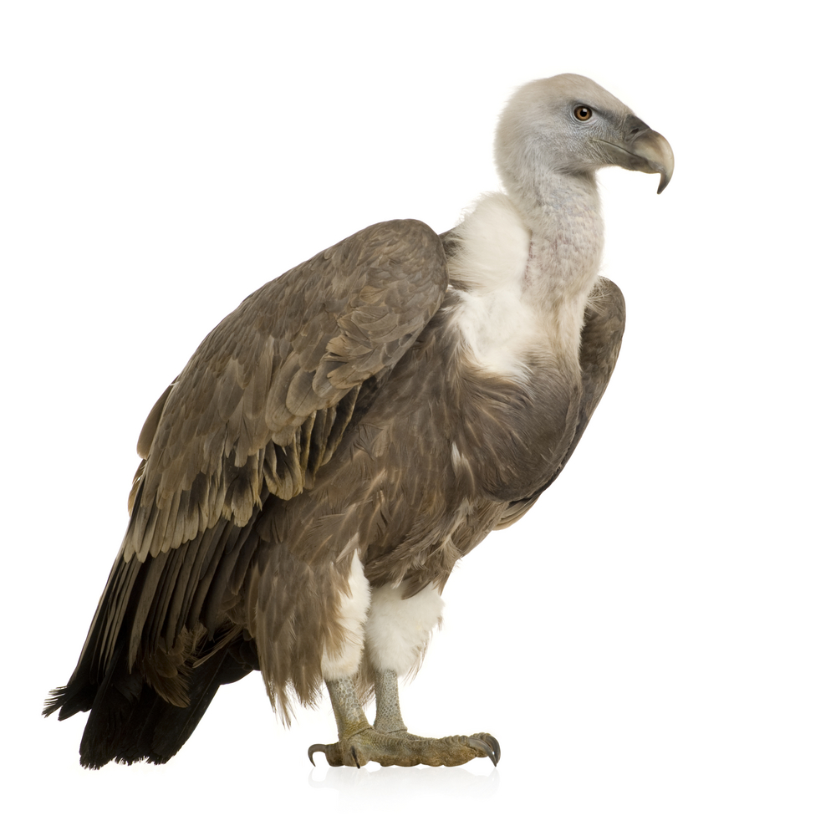
Notes:
See this [wiggle]? This is a vulture! Can you tell Maggie what vultures are for?

Slide 27
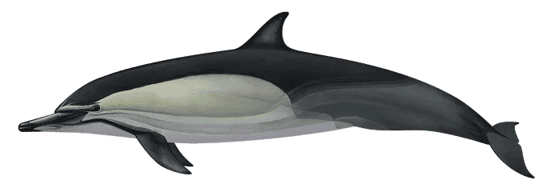
Notes:
See this [wiggle]? This is a dolphin! Can you tell Maggie what dolphins are for?

Slide 28
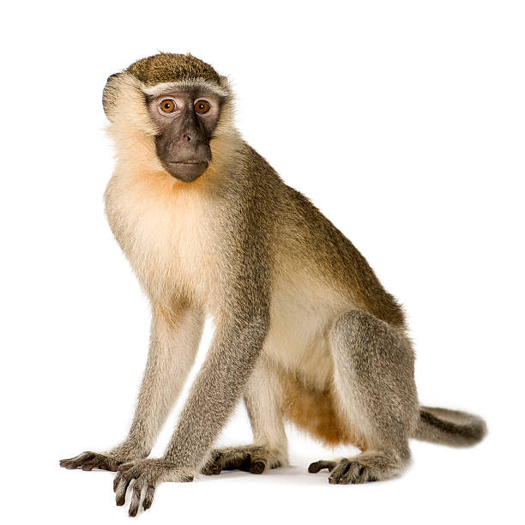
Notes:
See this [wiggle]? This is a monkey! Can you tell Maggie what monkeys are for?

Slide 29
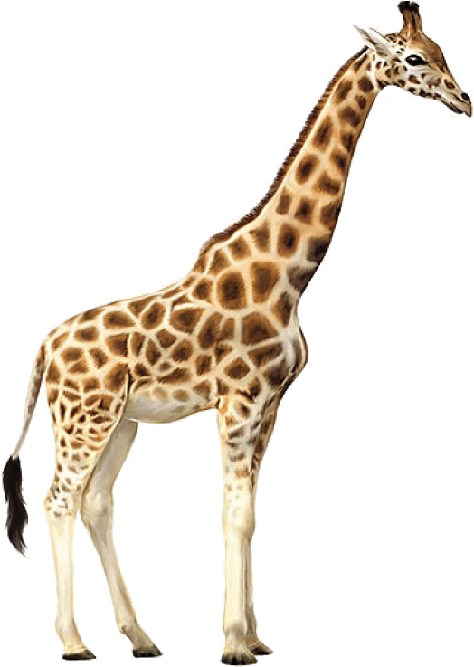
Notes:
See this [wiggle]? This is a giraffe! Can you tell Maggie what giraffes are for?

Slide 30
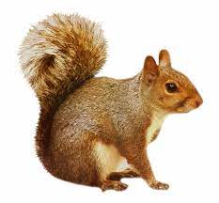
Notes:
See this [wiggle]? This is a squirrel! Can you tell Maggie what squirrels are for?

Slide 31
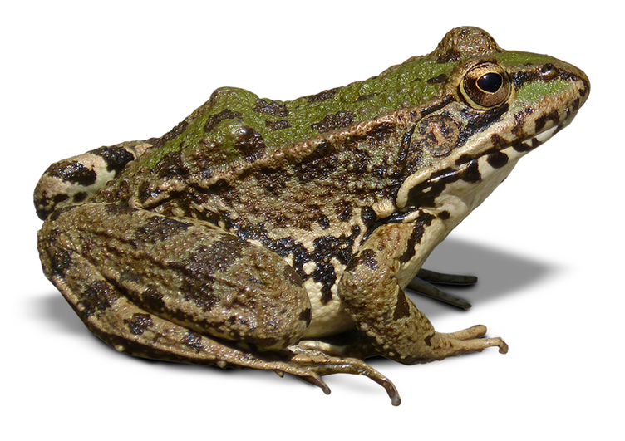
Notes:
See this [wiggle]? This is a frog! Can you tell Maggie what frogs are for?

Slide 32
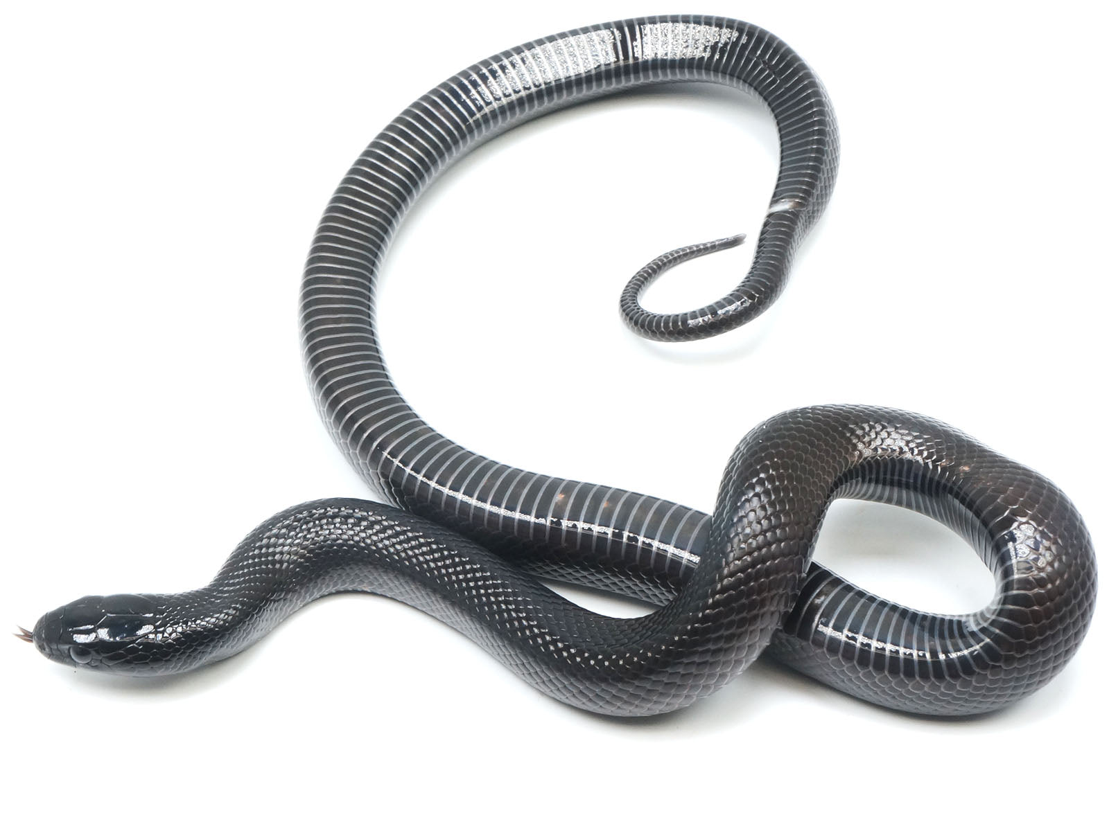
Notes:
See this [wiggle]? This is a snake! Can you tell Maggie what snkaes are for?

Slide 33
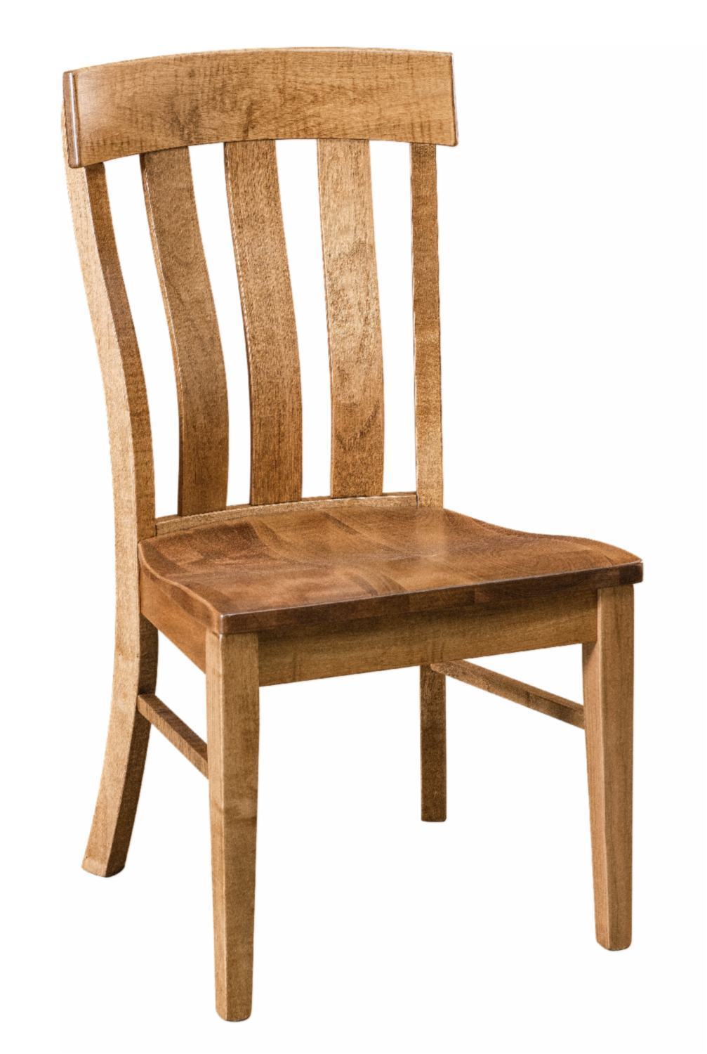
Notes:
See this [wiggle]? This is a chair! Can you tell Maggie what chairs are for?

Slide 34
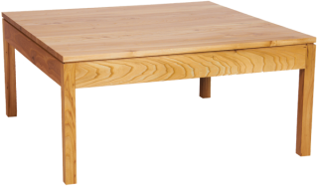
Notes:
See this [wiggle]? This is a table! Can you tell Maggie what tables are for?

Slide 35
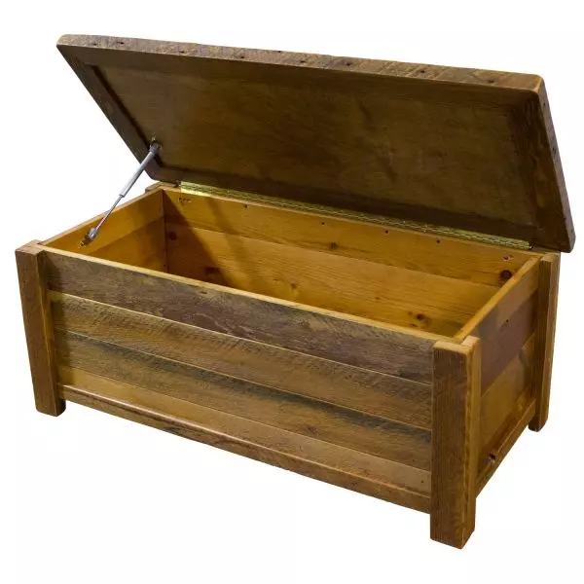
Notes:
See this [wiggle]? This is a toybox! Can you tell Maggie what toyboxes are for?

Slide 36
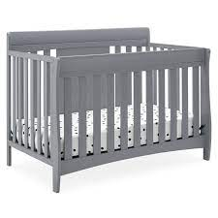
Notes:
See this [wiggle]? This is a baby crib! Can you tell Maggie what wagons are for?

Slide 37
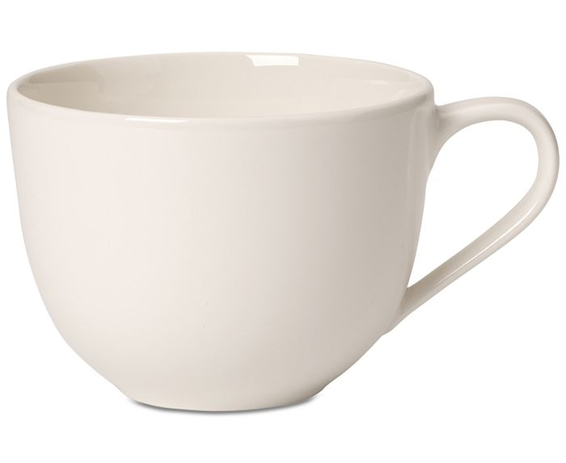
Notes:
See this [wiggle]? This is a cup! Can you tell Maggie what cups are for?

Slide 38
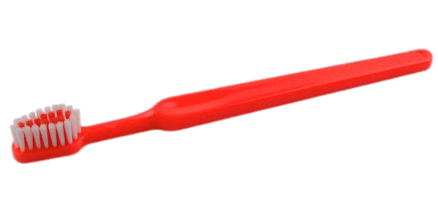
Notes:
See this [wiggle]? This is a toothbrush! Can you tell Maggie what toothbrushes are for?

Slide 39

Notes:
See this [wiggle]? This is a comb! Can you tell Maggie what combs are for?

Slide 40
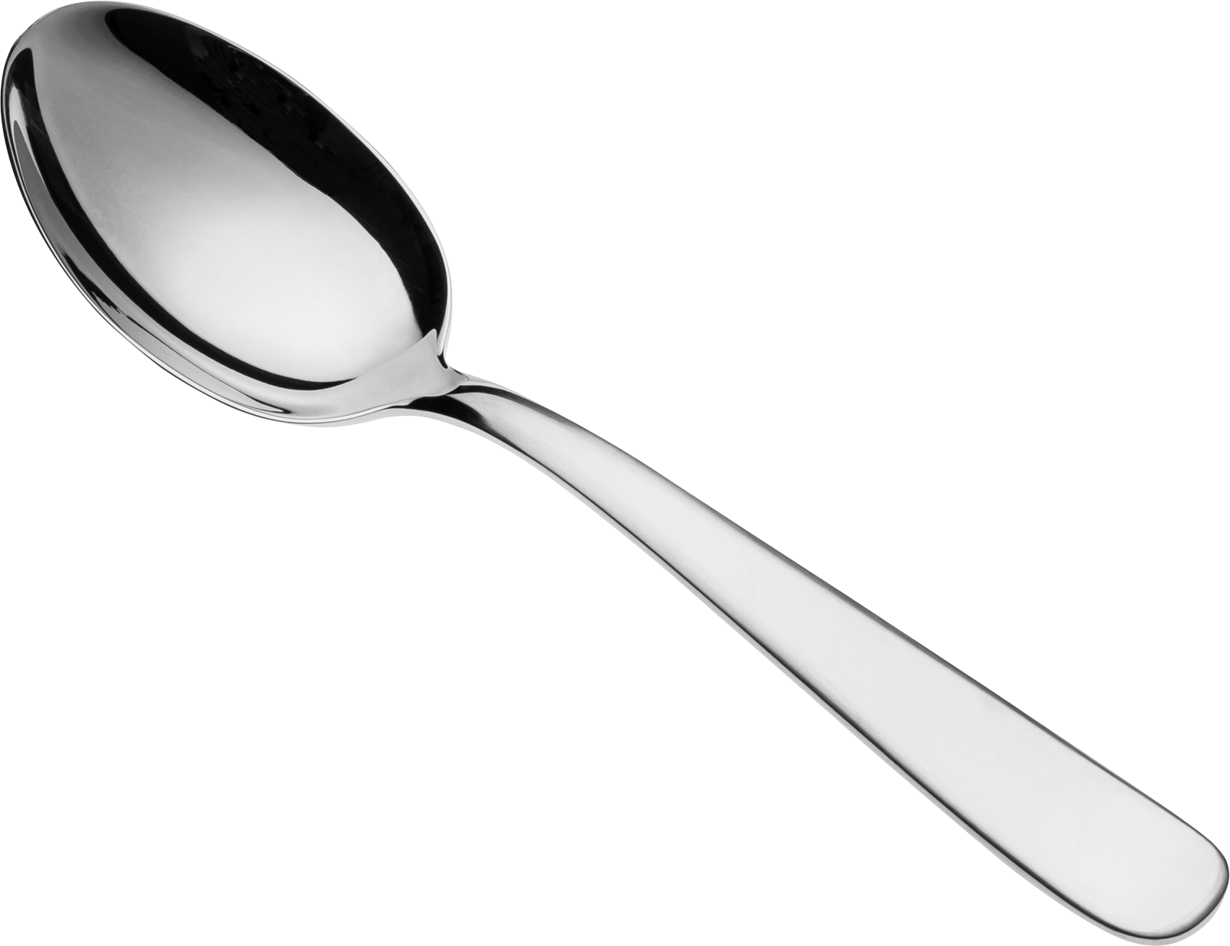
Notes:
See this [wiggle]? This is a spoon! Can you tell Maggie what spoons are for?

Slide 41
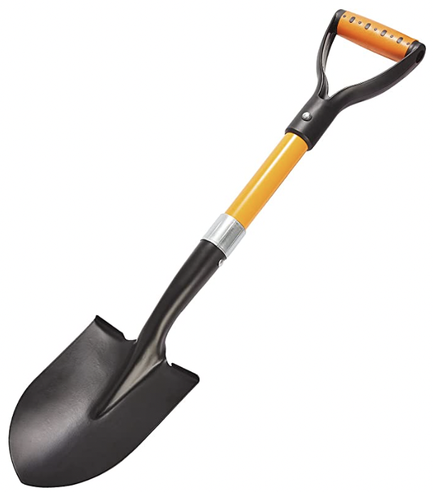
Notes:
See this [wiggle]? This is a shovel! Can you tell Maggie what shovels are for?

Slide 42
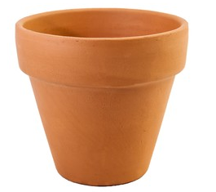
Notes:
See this [wiggle]? This is a flower pot! Can you tell Maggie what flower pots are for?

Slide 43
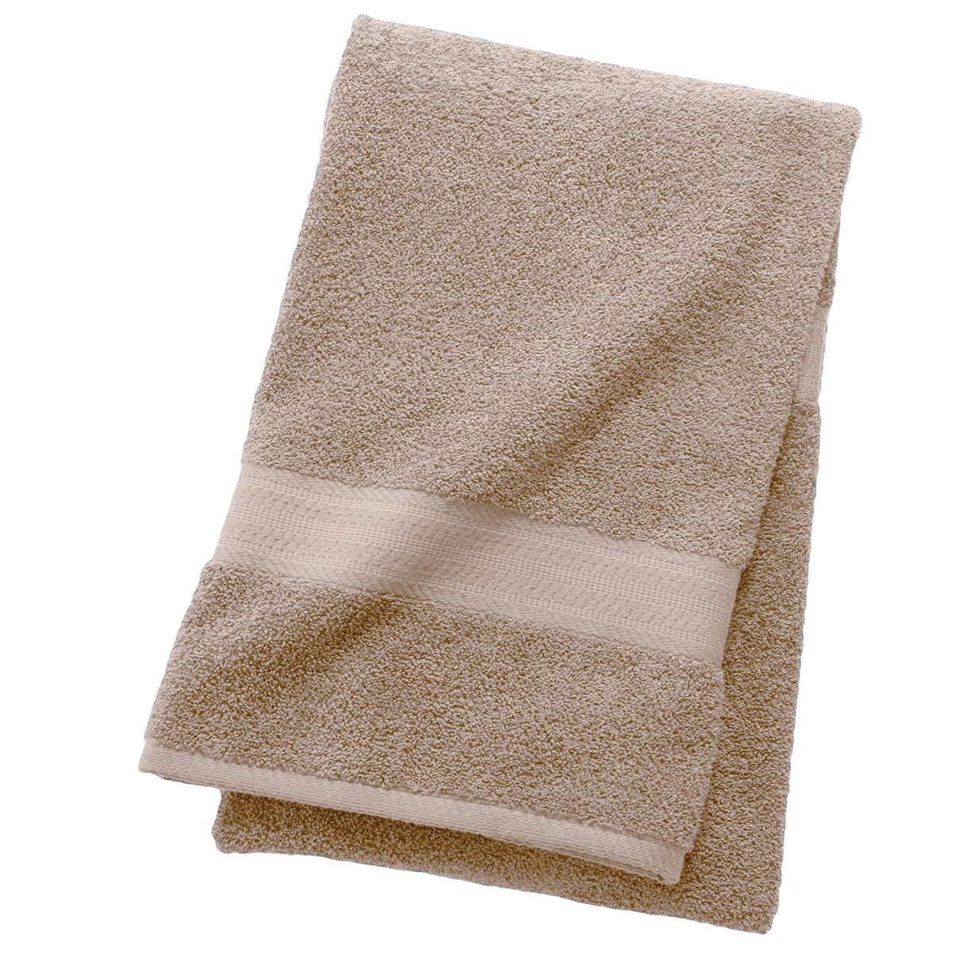
Notes:
See this [wiggle]? This is a towel! Can you tell Maggie what towels are for?

Slide 44
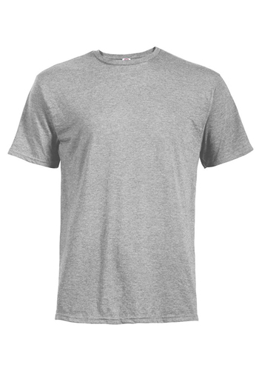
Notes:
See this [wiggle]? This is a shirt! Can you tell Maggie what shorts are for?

Slide 45
1. How was the video quality?
1
2
3
4
5
Very poor
Moderate
Very good
Notes:
can you tell me how the video quality was throughout the study, from 1 being the worst and 5 being the best?
Could you see me okay?

Slide 46
2. How was the sound quality?
1
2
3
4
5
Very poor
Moderate
Very good
Notes:
How about the sound quality? Could you hear me okay?

Slide 47
3. How fun was the activity?
1
2
3
4
5
Not very fun
Moderately fun
Very fun
Notes:
And how fun was the activity ?

Slide 48
Participant Recording Options
Please choose a level of consent option for your child’s video.
1. Research Only
Viewed only by our team.
2. Academic/Educational Use
May be presented as examples at conferences or classes.
3. Public
May be e.g. presented publicly online for public outreach & dissemination of findings.
Notes:
Lastly, how you would like us to use our recording of today’s session? The baseline level of privacy is level 1, research only, which means only the experimenters in our lab will have access to the videos.
I’d be happy to describe the 2 additional levels of privacy if you’re interested - they’re really helpful for us but totally optional. Level 2 allows us to use your child’s video as an example at conferences or classes. Level 3 means your child’s video may be made public. Which level of consent would you be comfortable with?

Slide 49

Expect your child’s $5 gift card to arrive in 1 – 5 business days!
Notes:
That was our last question – thank you so much for taking the time to participate in our study today!

